Slide 1
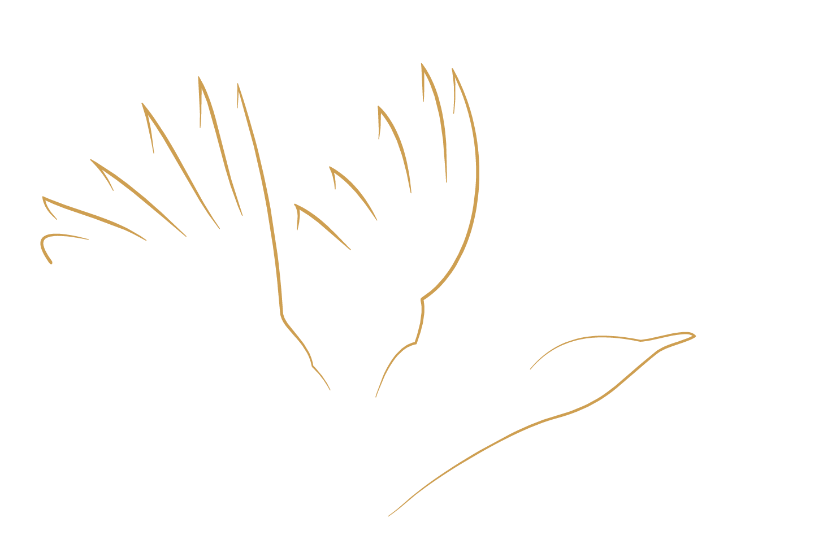
Food availability study
Protocol and data
2025

Slide 2
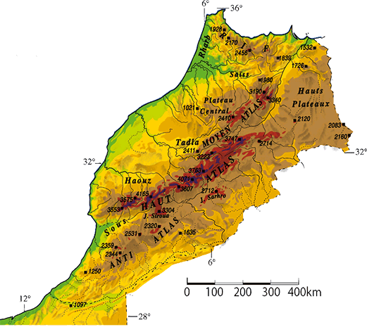
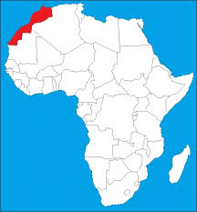

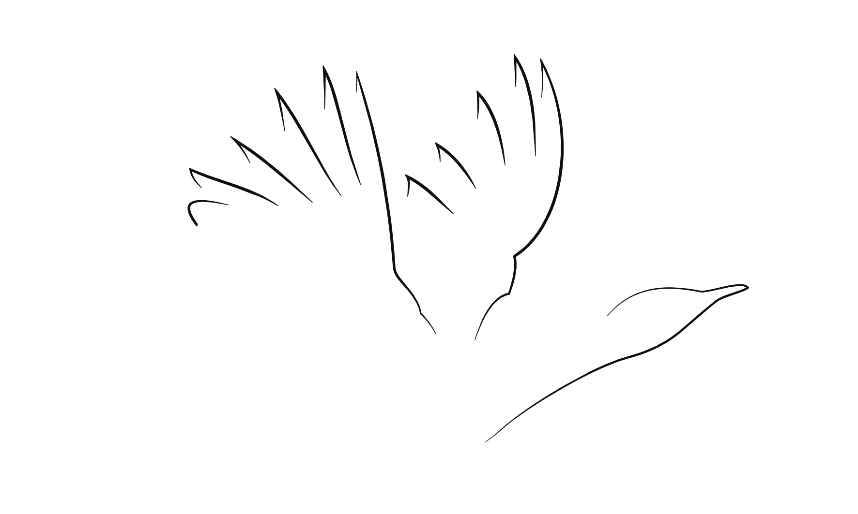
Food availability study
Summary of the protocol (Arthropods)
Project | Study square | Size Km | Fenced area | Habitat area | Study sites | Traps | Start date | Season | Habitats | Samples / year * | Sampled surface m²
ECWP | 13 | 5x5 | 4 | 8 | 114 | 456 | 17/04/2017 | 4 | 5 | 3648 | 182400
Eastern | 11 |  | 4 | 7 | 101 | 404 |  |  |  | 3232 | 161600
South | 2 |  | - | 1 | 13 | 52 |  |  |  | 416 | 20800
* Theoretical figures without additional trappings

Slide 3
Food availability study
Trapping design
Study square 5x5 km
Study site 40x40m
Pitfall trap

Slide 4

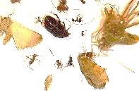








Food availability study
Fractions sorted out
Tenebrionidae
Houbara diet
Other Tenebrionidae
Other
Total fractions
Messor
ECWP
4
2017 - 2024
ECWP
3
2025 - …
Tenebrionidae

Slide 5
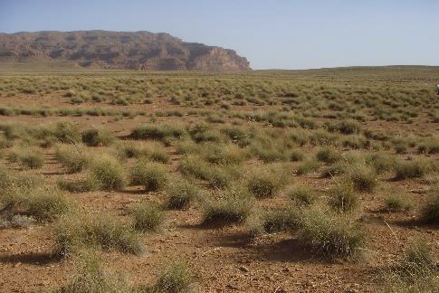
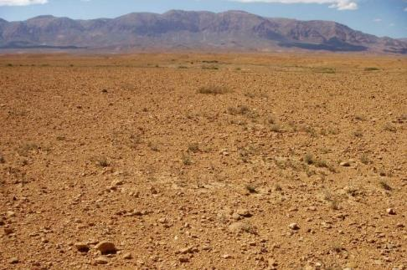
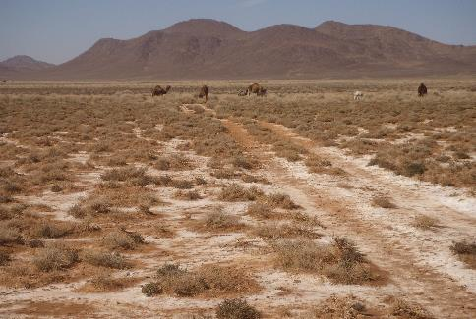
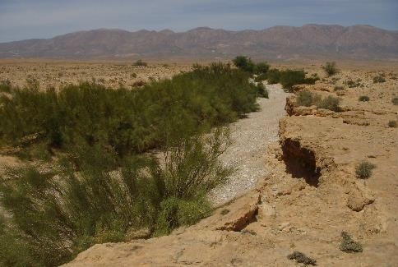
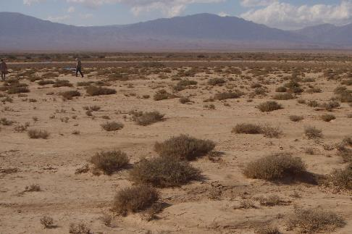
Food availability study
Habitats
Halfah grass
ECWP
Halfah grass steppe Reg Alluvial silt plain Drainage line and Wadi Salt steppes
Reg
Salt steppe
Wadi
Silt plain

Slide 6
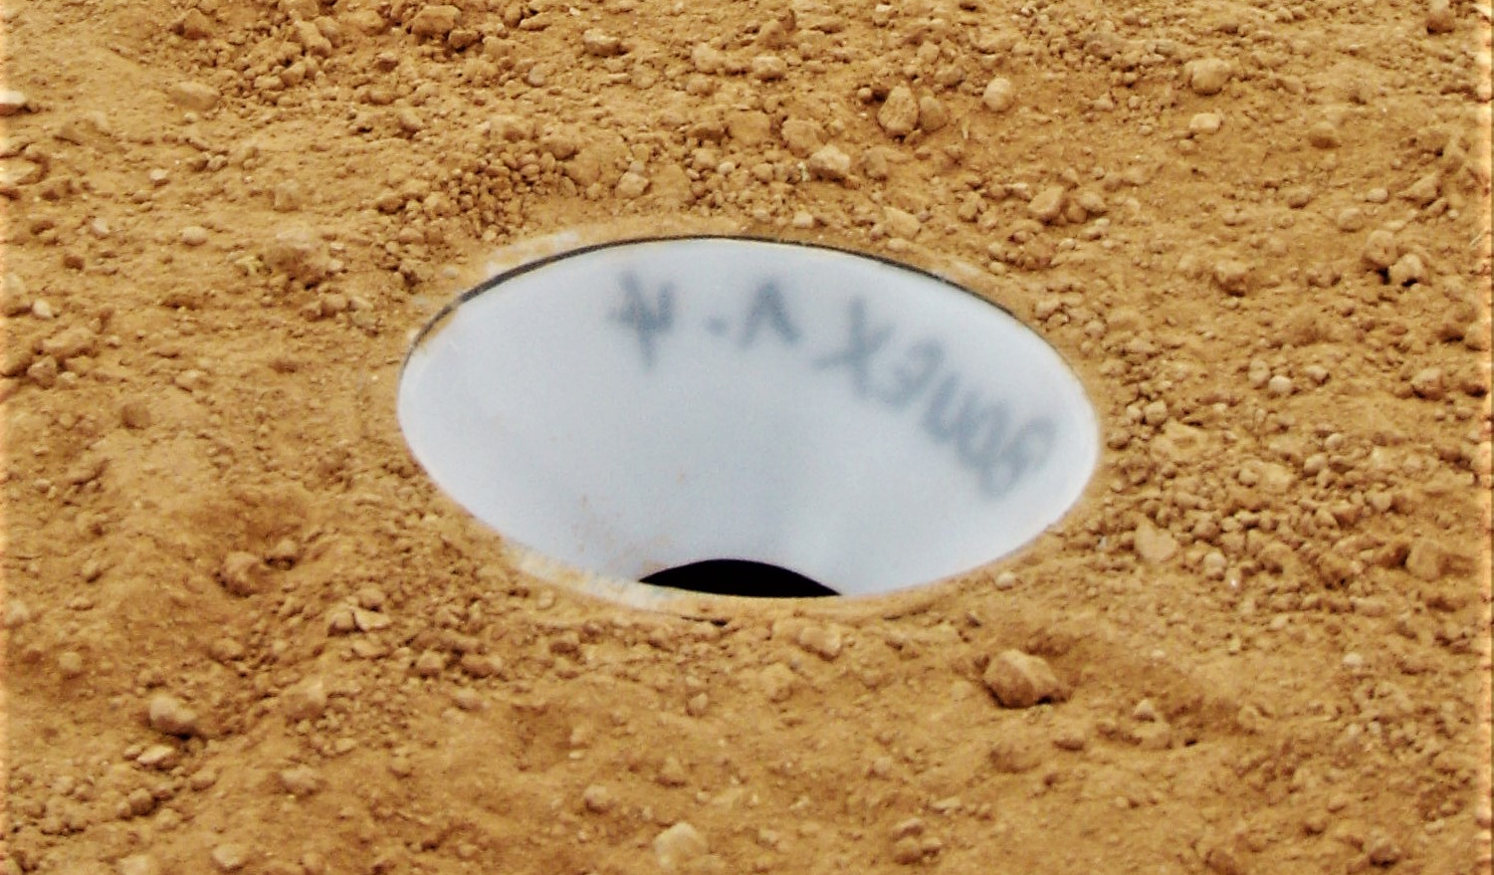
Food availability study
Morocco: protocol evolution
First Messor nests density survey (test) and circadian rhythms study inside ECWP
First trapping implemented on 10 study squares (Eastern)
Trapping survey on 10 study squares (Eastern)
Trapping survey on 11 study squares (Eastern)
Trapping survey on 11 study squares (Eastern)
Trapping survey on 11 study squares (Eastern)
Trapping survey on 11 study squares (Eastern)
Trapping survey on 11 study squares (Eastern)
Trapping survey on 11 study squares (Eastern)
Trapping survey on 11 study squares (Eastern)
4 fenced areas
4 fenced areas
4 fenced areas
4 fenced areas
4 fenced areas
4 fenced areas
4 fenced areas
4 fenced areas
4 habitats
7 habitats
7 habitats
7 habitats
7 habitats
7 habitats
7 habitats
7 habitats
2014
2015
2016
2017
2018
2019
2020
2021
2022
2023
Traps
200
344
404
404
404
404
404
404
404
Drying time protocol

Slide 7
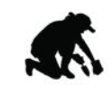

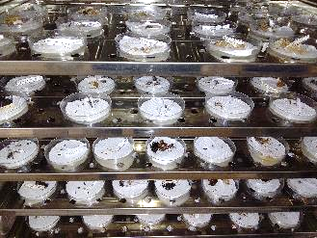
Food availability study
Human resource
8 fieldworkers
3,5 laboratory assistants
360 samples sorted out per month
In 2022: 379 days-worker to set and check pitfall traps
(33 days-worker more than the theoretical number - 346)
320 samples weighed per month
14 months to process all the samples of one trapping year

Slide 8
Food availability study
Data Summary (Eastern Morocco)
Year | Study sites | Traps | Habitats | Messor ants | Teneb. Houbara diet | Teneb. Other | Teneb. Whole family | Other | Samples / year | Data / year
2015 | 50 | 200 | 4 | Nber/Wght | Nber/Wght | Nber/Wght | / | Wght | 1600 | 6400
2016 | 86 | 344 | 4 | Nber/Wght | Nber/Wght | Nber/Wght | / | Wght | 2752 | 11008
2017 | 101 | 404 | 5 | Nber/Wght | Nber/Wght | Nber/Wght | / | Wght | 3232 | 12928
2018 | 101 | 404 | 5 | Nber/Wght | Nber/Wght | Nber/Wght | / | Wght | 3232 | 12928
2019 | 101 | 404 | 5 | Nber/Wght | Nber/Wght | Nber/Wght | / | Wght | 3232 | 12928
2020 | 101 | 404 | 5 | Nber/Wght | Nber/Wght | Nber/Wght | / | Wght | 3232 | 12928
2021 | 101 | 404 | 5 | Nber/Wght | Nber/Wght | Nber/Wght | / | Wght | 3232 | 12928
2022 | 101 | 404 | 5 | Nber/Wght | Nber/Wght | Nber/Wght | / | Wght | 3232 | 12928
2023 | 101 | 404 | 5 | Nber/Wght | Nber/Wght | Nber/Wght | / | Wght | 3232 | 12928
2024 | 101 | 404 | 5 | Nber/Wght | Nber/Wght | Nber/Wght | / | Wght | 3232 | 12928
2025 | 101 | 404 | 5 | Nber/Wght | / | / | Nber/Wght | Wght | 3232 | 9696
In red: to be completed

Slide 9
Food availability study
Data table
Study site | Habitat | Trap code | Coord. | Alt. | Date | Period | Fraction | Number | Dry weight(g) | Observations | status
VB17NW1 | REG | VB17NW11 | N33.24393 W3.95261 | 988 | 12/04/2021 | April | Tenebrionidae Houbara diet | 2 | 0,10477 |  | WT
VB17NW1 | REG | VB17NW11 | N33.24393 W3.95261 | 988 | 12/04/2021 | April | Tenebrionidae other | 0 |  |  | WT
VB17NW1 | REG | VB17NW11 | N33.24393 W3.95261 | 988 | 12/04/2021 | April | Messor | 1 | 0,00230 |  | WT
VB17NW1 | REG | VB17NW11 | N33.24393 W3.95261 | 988 | 12/04/2021 | April | Other |  | 0,06410 |  | WT
VB17NW1 | REG | VB17NW12 | N33.24378 W3.95208 | 986 | 12/04/2021 | April | Tenebrionidae Houbara diet | 0 |  |  | WT
VB17NW1 | REG | VB17NW12 | N33.24378 W3.95208 | 986 | 12/04/2021 | April | Tenebrionidae other | 0 |  |  | WT
VB17NW1 | REG | VB17NW12 | N33.24378 W3.95208 | 986 | 12/04/2021 | April | Messor | 0 |  |  | WT
VB17NW1 | REG | VB17NW12 | N33.24378 W3.95208 | 986 | 12/04/2021 | April | Other |  | 0,11254 |  | WT
VB17NW1 | REG | VB17NW13 | N33.24335 W3.95221 | 986 | 12/04/2021 | April | Tenebrionidae Houbara diet | 0 |  |  | WT
VB17NW1 | REG | VB17NW13 | N33.24335 W3.95221 | 986 | 12/04/2021 | April | Tenebrionidae other | 0 |  |  | WT
VB17NW1 | REG | VB17NW13 | N33.24335 W3.95221 | 986 | 12/04/2021 | April | Messor | 0 |  |  | WT
VB17NW1 | REG | VB17NW13 | N33.24335 W3.95221 | 986 | 12/04/2021 | April | Other |  | 0,02740 |  | WT
Non working trap | NWT
Bias possible | BP
Working trap | WT

Slide 10
Food availability study
Morocco: sampling effort
The percentage of valid samples is obtained after invalidating flooded samples, rotten samples, sample jars full of sand
The disturbance is calculated on the real number of samples that are collected in the stations. It informs on the trapping disruptions like pitfall trap damage, loss or impossible access to the study site
Data quality control
Corrections

Slide 11
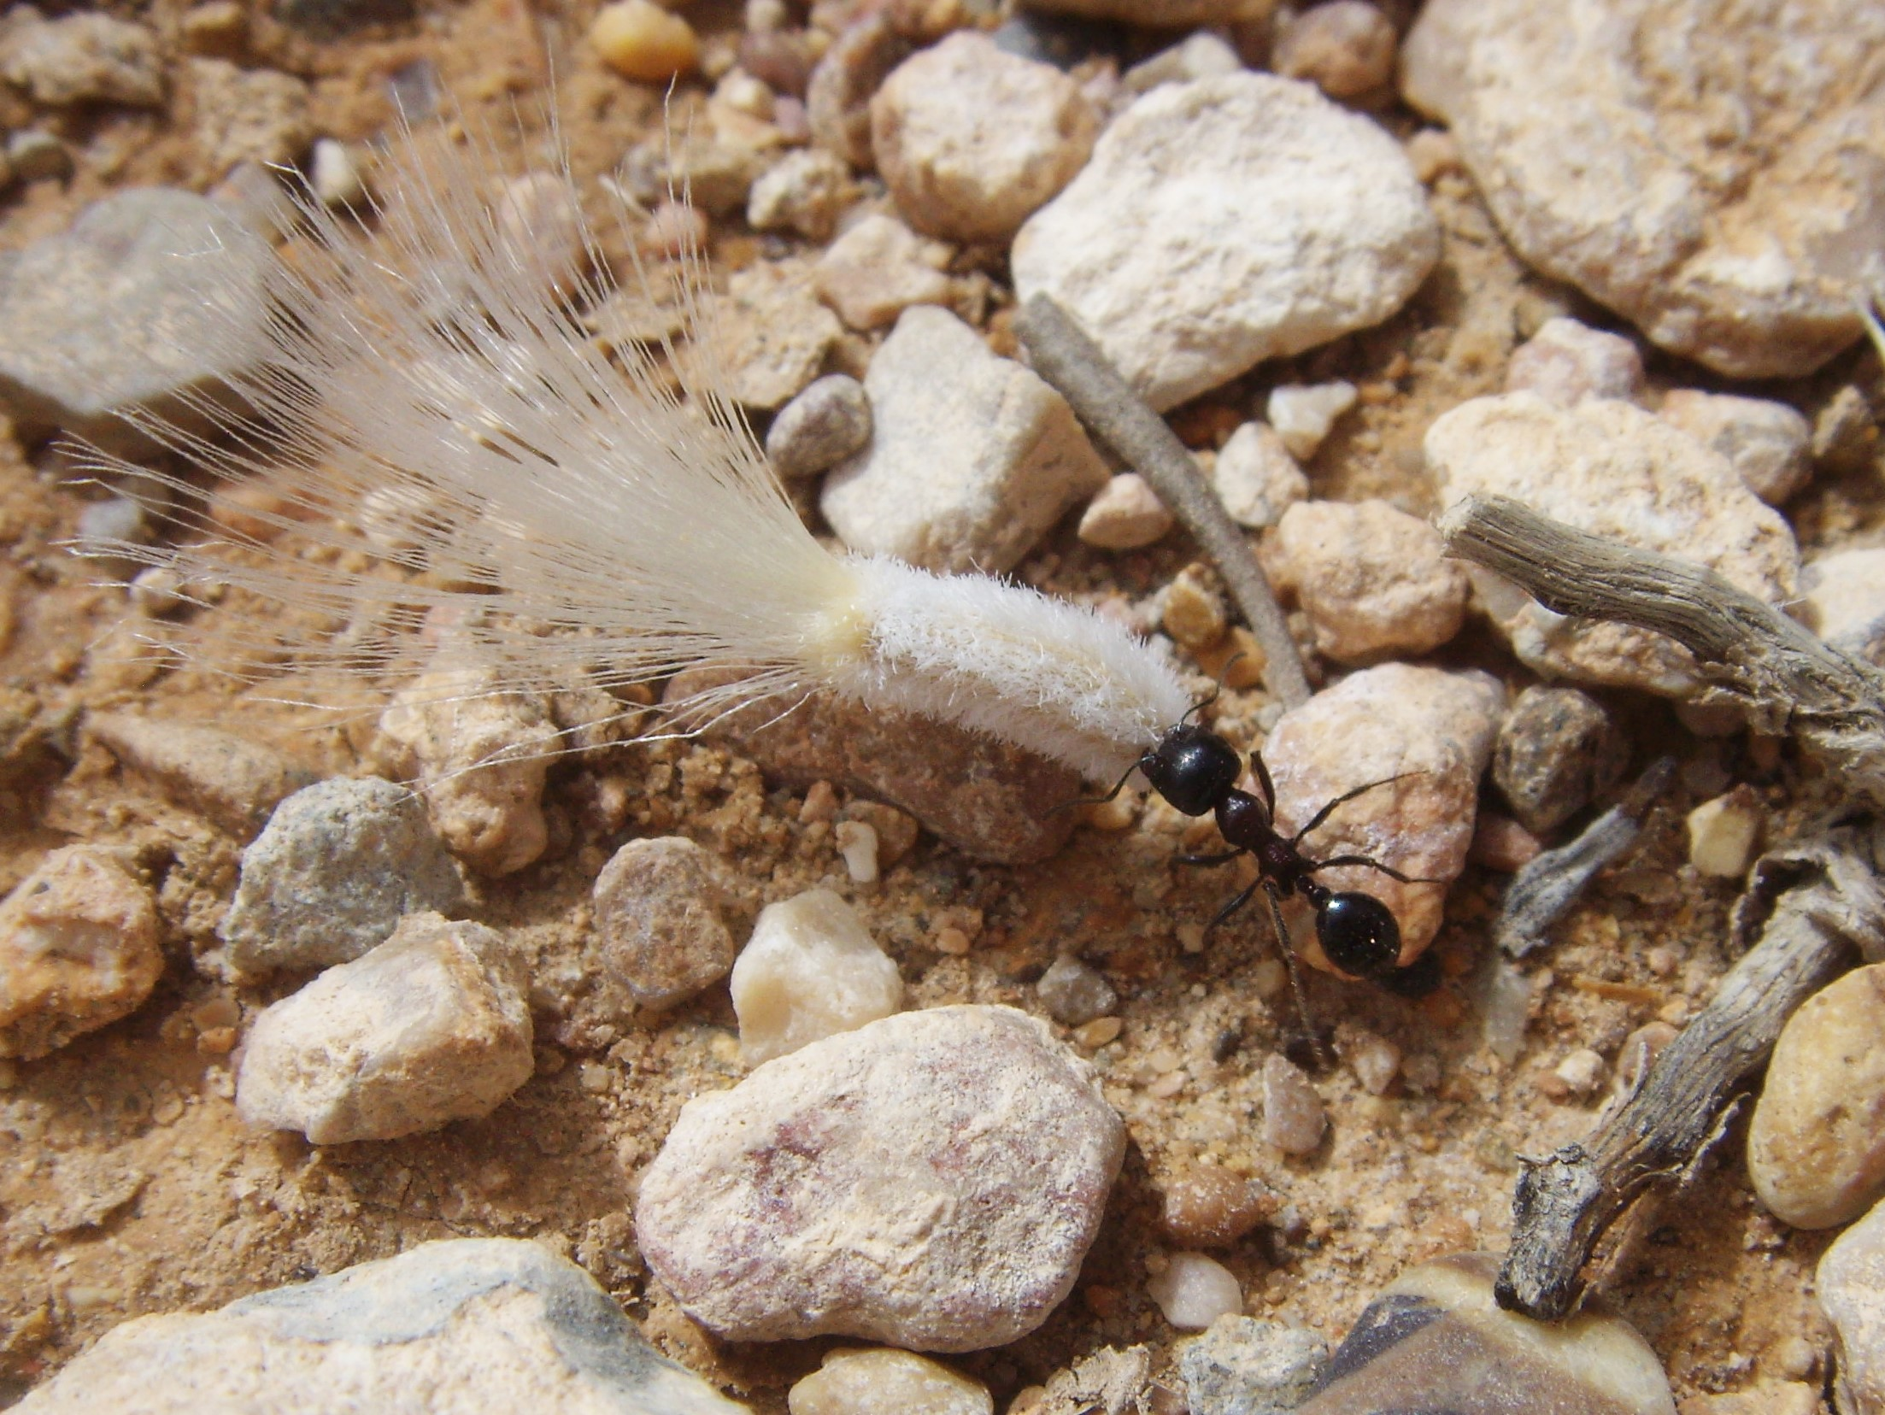
Food availability study
Thank you !

